Slide 1
Leveraging Business Intelligence to Identify Profitable Movie Investment Opportunities
Presented By
Arafat Islam
Tanvir Hasan
Pauli Klemettilä
Abdullah Reza
Andrey Verbovskiy

Slide 2
Introduction

Slide 3
Objective of the Study
:
Purpose: To conduct a comprehensive analysis of the movie industry, utilizing business intelligence tools to identify trends that inform profitable investment decisions.
Goal: To enable potential investors to make data-driven decisions by understanding which types of movies yield the best returns.

Slide 4
Business questions
By answering these questions, we could help investors in making informed decisions about what types of movies are worth investing in.
Which genres of movies are more popular than others?
What budget range is most effective for maximizing audience engagement in niche genres?
Which had the highest customer rating for the movies?
What types of movies are most popular per each dollar of investment?
What types of movies are most appreciated by the customers?
What are the trends following revenue, cost and customer rating in terms of genre
Which had the highest customer rating for the movies.
How much money would a movie require to achieve the highest popularity in its specific genre?
Which genre of movies provide average revenue to cost?
Which genres have more budgets?

Slide 5
About Data

Slide 6
Dataset
Metadata for 45,000 movies listed in the Full MovieLens Dataset up to July 2017.
Data points include cast, crew, plot keywords, budget, revenue, posters, release dates, languages, production companies, countries, TMDB vote counts and vote averages.
This dataset also has files containing 26 million ratings from 270,000 users for all 45,000 movies.
Ratings range from 1 to 5, sourced from the official GroupLens website.

Slide 7
Preprocessing
Identified and removed missing values, especially in critical fields like movie names and genres.
Excluded films with budgets under $100,000 to mitigate analysis biases.
Conducted validation tests to address outliers and discrepancies.

Slide 8
Dashboard

Slide 9
Parts of the Dashboard
The Dashboard is separated into 4 parts.
Part 1: Details of the data
Part 2: popularity based decision
Part 3: Financial data for decision making
Part 4: Trending genre based decision making

Slide 10
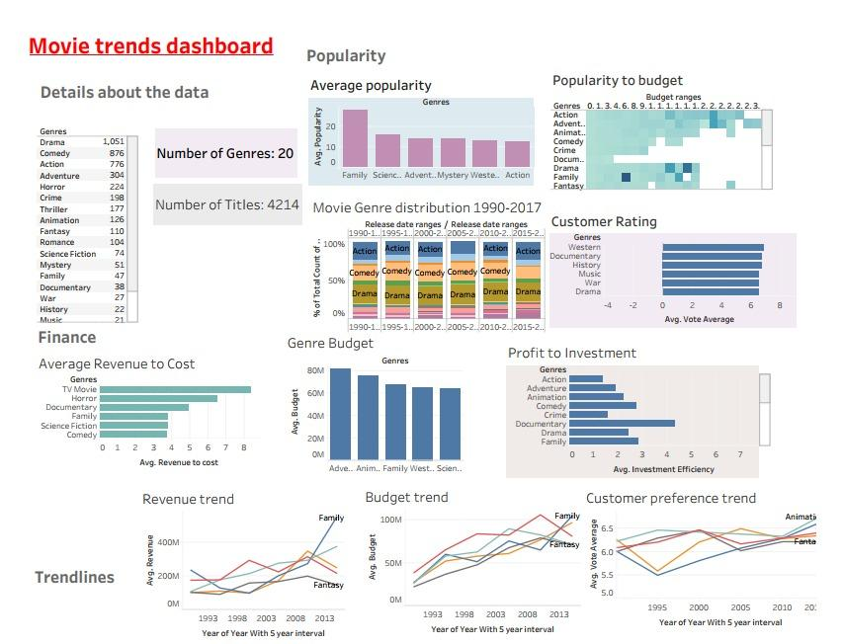

Slide 11
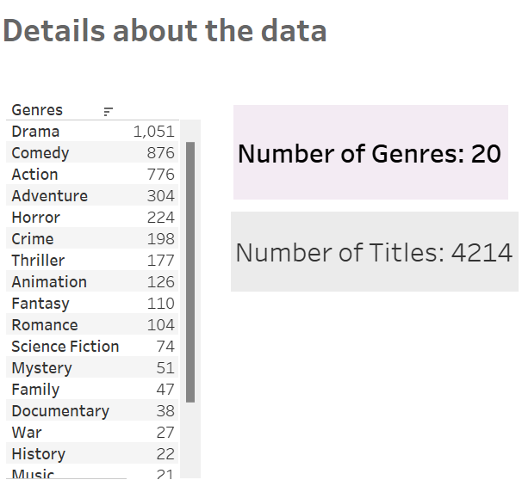
Details of the data
The highest number of movie genre was DRAMA.

Slide 12
Popularity
Customer rating wise popularity
Movie genre distribution 1990-2017
Budget ranges across the genres in relation to popularity

Slide 13
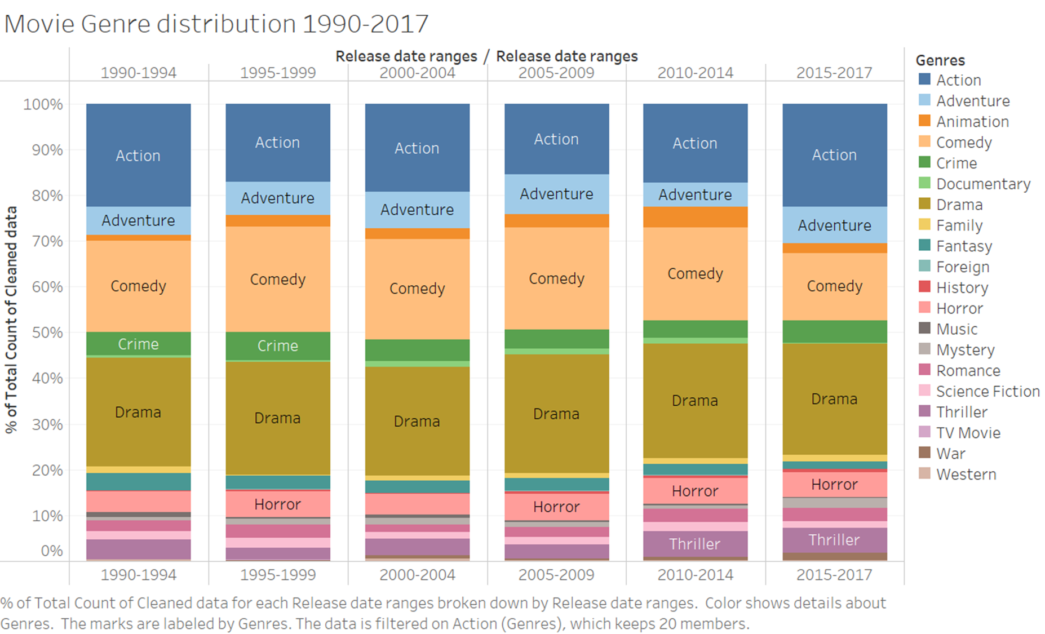
Movie genre distribution 1990-2017
Genre Stability: Action, adventure, comedy, and drama.
Decline in Comedy and Fantasy
Trends in Family and Animated Films

Slide 14
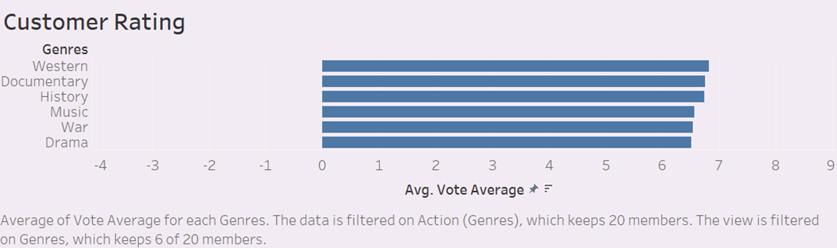
Customer rating wise popularity
Despite some variations, differences in genre popularity based only on ratings are unclear.
Westerns and Documentaries are popular, but overall preferences are similar across genres.
Drama, War, Music, History, Family, and Documentary genres are highly liked.
Viewers prefer movies with deep stories, emotions, and insightful content.

Slide 15
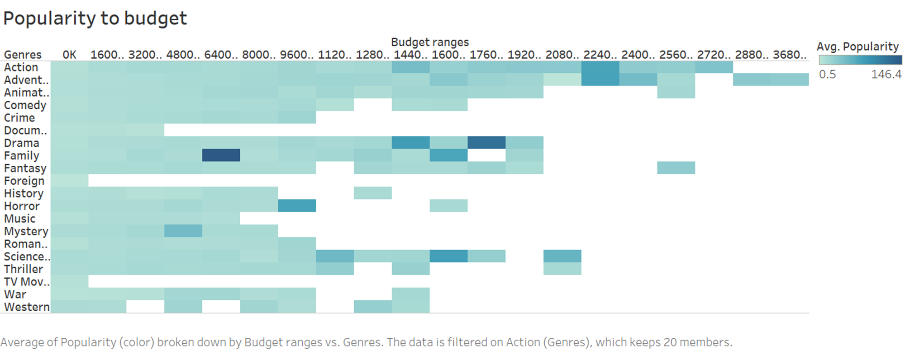
Budget ranges across the genres in relation to popularity
For most of the genres the popularity is equally distributed among budget ranges​
With exceptions being drama, family and science fiction.

Slide 16
Financial
Average revenue to cost ratio
Genres Budget
Profit from investments

Slide 17
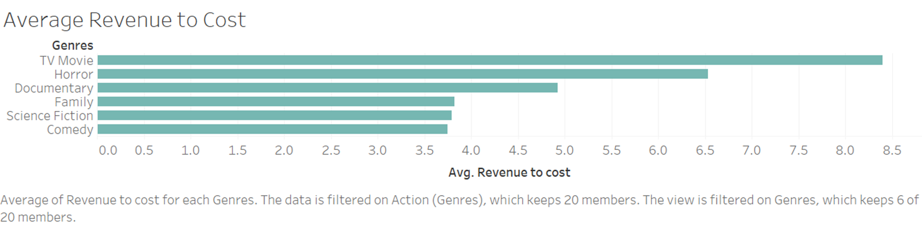
Average revenue to cost ratio
TV movie has the highest revenue to cost ratio though sample size for TV movies is low
Horror movie for as it gives 6.5 dollars for each Dollar invested

Slide 18
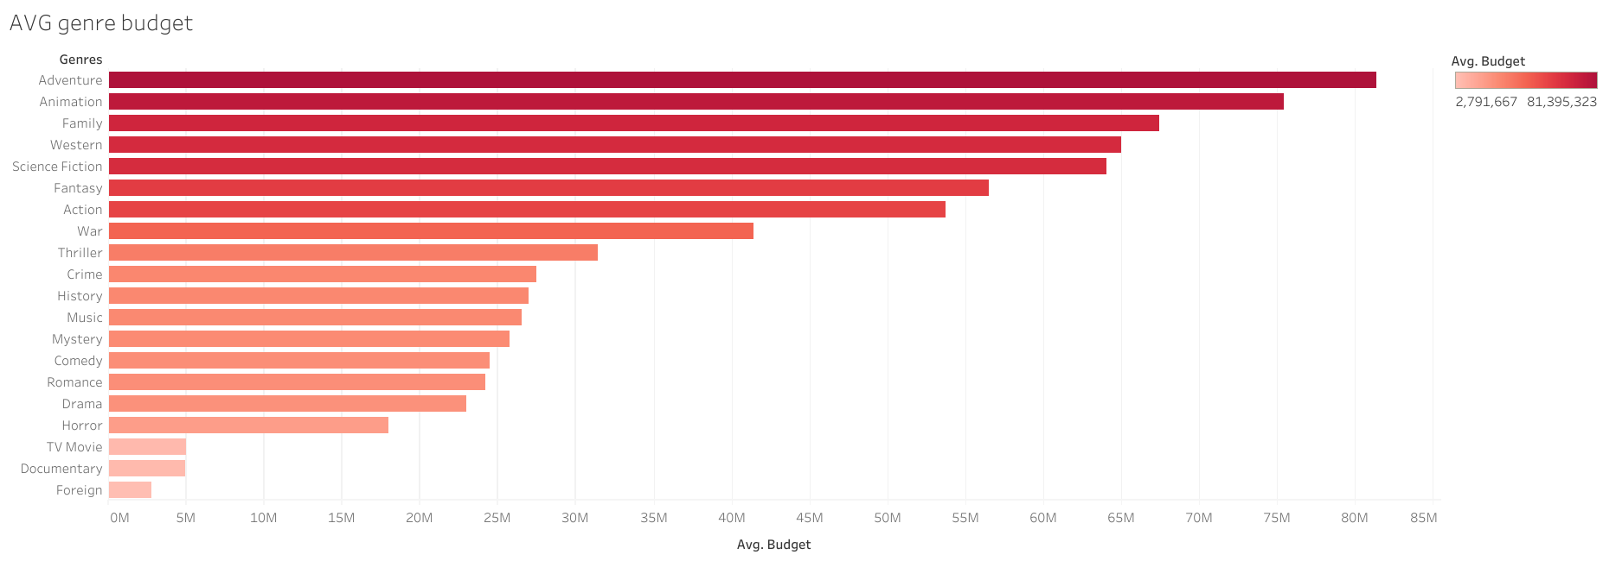
Genres Budget
Adventure films were the most expensive, with an average budget of $81.3 million, while Animation films came in second, with an average budget of $75.4 million.
Foreign films had the lowest average budget at $2.7 million.

Slide 19
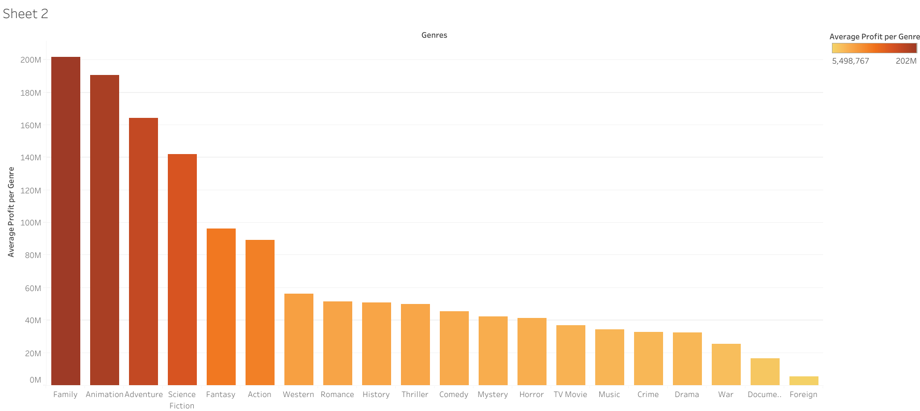
Profit from investments
Average profit=SUM([Profit]) / COUNTD ([IMDB Id]), where profit=[Revenue] - [Budget]
Highest average profits per movie genre are earned by the Family (200M), Animation (190M), Adventure(165M), and Science Fiction (142M) genres. foreign, war, and documentary films are often regarded as riskier.

Slide 20
Trends
Revenue Trend
Budget Trend
Customer Preference Trend

Slide 21
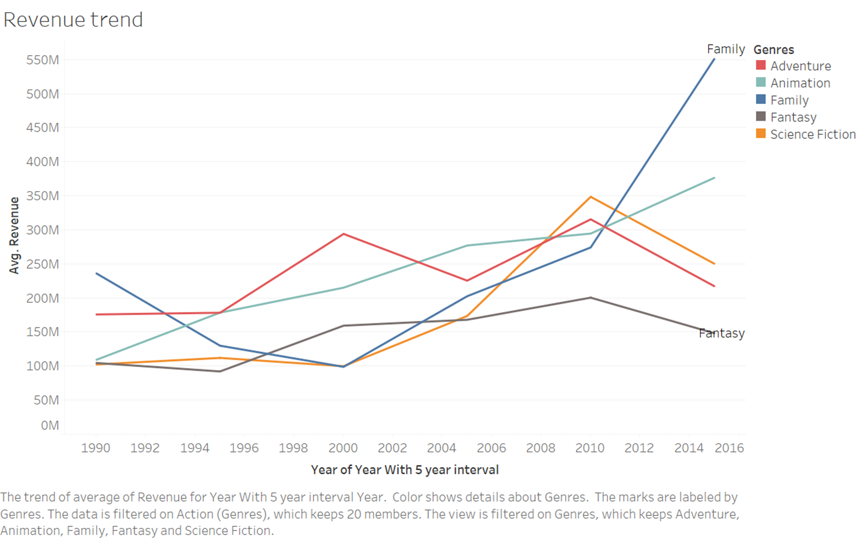
Revenue Trend
The family genre shows a significant upward trend, particularly post-2010, indicating a strong growth in revenue, surpassing all other genres by 2016.
The fantasy genre shows an erratic performance and experiences a sharp decline in revenue after 2010.
Adventure and science fiction genres show steady growth, while animation shows moderate growth with some fluctuations.

Slide 22
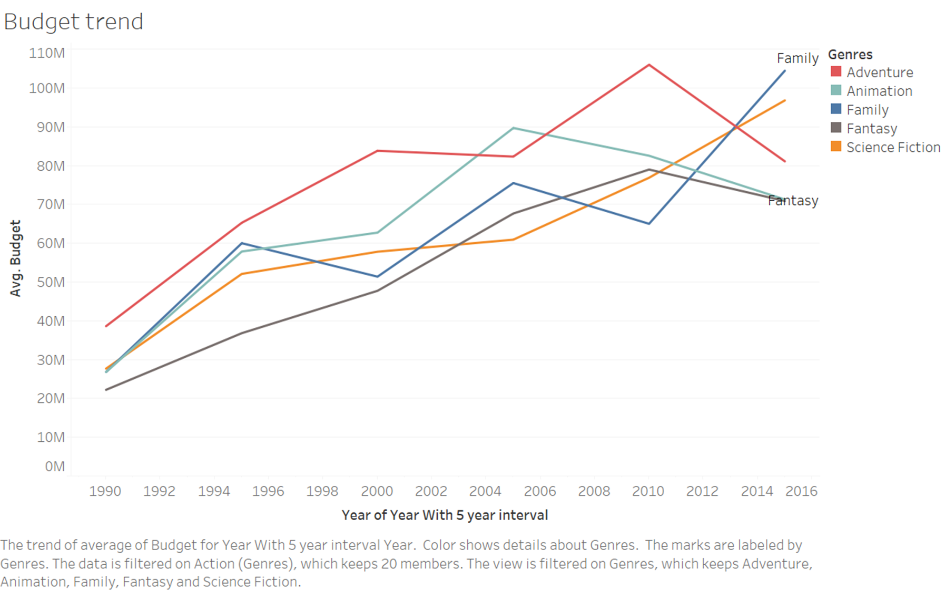
Budget Trend
Family genre shows a steep increase in budget allocation over time.
Fantasy and adventure genres also show increases in budget allocations, aligning closely with their revenue trends.
The budget for science fiction movies sees a steady increase

Slide 23
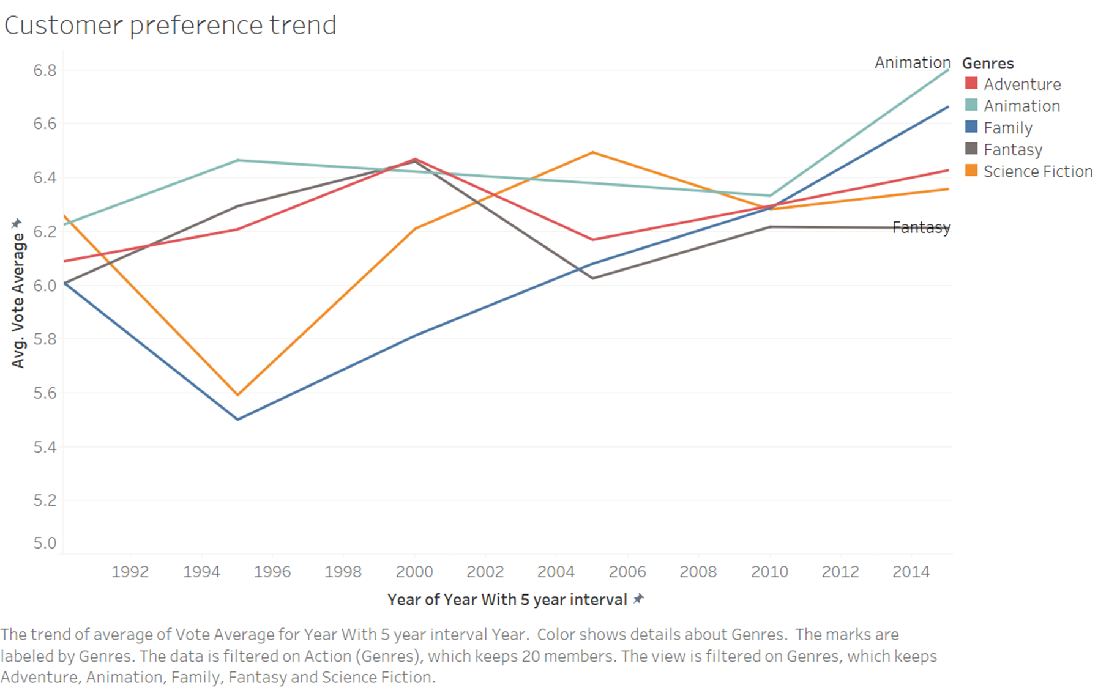
Customer Preference Trend
Animation receiving increasing favor.
Adventure and family genres generally maintain high customer ratings, while science fiction sees some growth in popularity.
Fantasy shows a decline in ratings

Slide 24
Findings

Slide 25
Criteria | Business questions | Findings
Popularity | Which genre of movies are more popular? | Our study shows drama, action and comedy genres have the highest average popularity.
 | What budget range is most effective for maximizing audience engagement in niche genres? | For most of the movie genres, the popularity is almost equally distributed among budget ranges, with exceptions of Drama and Family movie having distinct ranges where popularity is way higher.
 | Which had the highest customer rating for the movies. | Based on the customer ratings, mostly western and documentary movies are more popular.
 | How much money would a movie require to achieve the highest popularity in its specific genre? | With a heatmap provided, the highest popularity for each genre and budget ranges can be identified. The study shows that for the specific budget range the most popular movies in family genre are mostly in $64 million and for drama, the most popular movies are in the range of $176 million.

Slide 26
Criteria | Business questions | Findings
Finance | Which genre of movies provide average revenue to cost? | The average revenue-to-cost matrices show that the minimum TV movies has the highest average cost to revenue ratio. However, the sample size for this is too low for to be taken into account. So in this case Horror movies are the more prominent option.
 | Which genres have more budgets? | Adventure films were the most expensive, with an average budget of $81.3 million, while Animation films came in second, with an average budget of $75.4 million. Conversely, foreign films had the lowest average budget at $2.7 million.

Slide 27
Criteria | Business questions | Findings
Trends | Revenue and cost trend | Even though family movies have a higher revenue, it also has a higher cost margin. However, that is the best option in terms of trends in a financial sense
 | Popularity trend | In terms of popularity trend animation films have a very good steady customer feedback which is also the best feedback by the consumers. That would mean the animation films are in demand in terms of popularity

Slide 28
Decisions

Slide 29
Invest in Family, Animation and Adventure Genres when considering long-term growth
Horror an attractive genre for investors looking for quick returns on lower budgets
​
Selective Investment in High-Budget Genres​
Cautious Approach to Niche Genres

Slide 30


